Slide 1
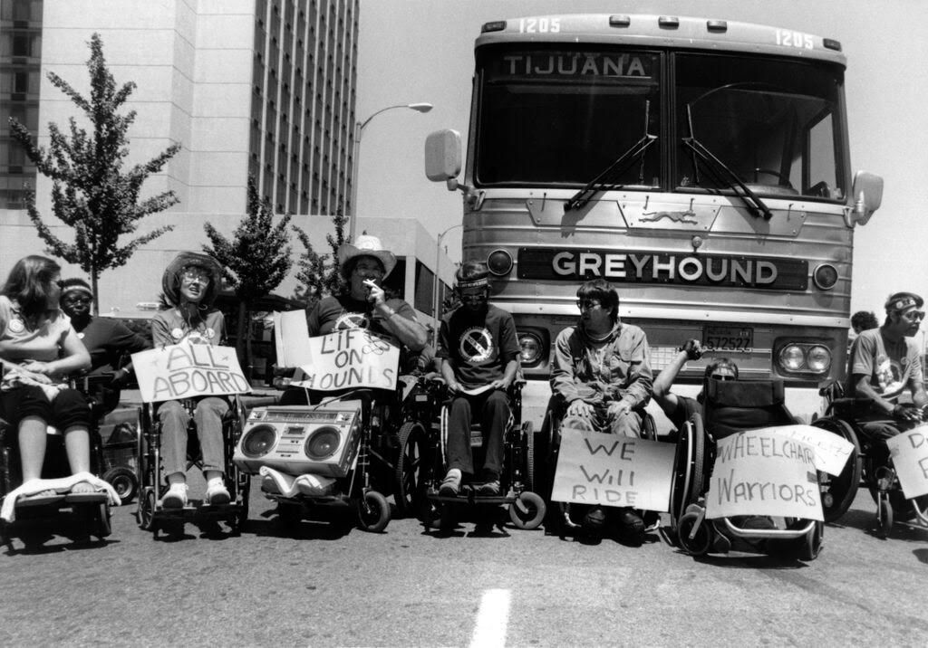
Radical Disability History 101
Robin M Eames
they/them
robin.m.eames@gmail.com

Slide 2
Please note that this presentation includes names and information about Aboriginal people who have died.
It also includes brief references to various kinds of violence, including state, medical, and sexual violence.

Slide 3
Overview
Models of disability
What is ableism?
History of disability activism: examples from the US and Australia
Disability justice and liberation
Organising and advocacy pathways

Slide 4
What is disability?
“Persons with disabilities include those who have long-term physical, mental, intellectual or sensory impairments which in interaction with various barriers may hinder their full and effective participation in society on an equal basis with others.”
(UN Convention on the Rights of Persons with Disabilities, 2006)

Slide 5
What is disability?
“Disabilities is an umbrella term, covering impairments, activity limitations, and participation restrictions. An impairment is a problem in body function or structure; an activity limitation is a difficulty encountered by an individual in executing a task or action; while a participation restriction is a problem experienced by an individual in involvement in life situations.
Disability is thus not just a health problem. It is a complex phenomenon, reflecting the interaction between features of a person’s body and features of the society in which he or she lives. Overcoming the difficulties faced by people with disabilities requires interventions to remove environmental and social barriers.”
(World Health Organisation, 2017)

Slide 6
“Illness is the night-side of life, a more onerous citizenship. Everyone who is born holds dual citizenship, in the kingdom of the well and in the kingdom of the sick. Although we all prefer to use the good passport, sooner or later each of us is obliged, at least for a spell, to identify ourselves as citizens of that other place.”
Susan Sontag, Illness as a Metaphor, 1978

Slide 7
Models of disability
Moral/religious
Charity
Medical
Social
Biopsychosocial
Political/relational

Slide 8
Models of disability
Moral/religious model
  considers disability to be a moral or religious affliction: acquired disability is seen as a divine punishment for the disabled person; congenital disability seen as punishment for the parents
Charity model
  considers disability as an unfortunate tragedy
  Disabled people are seen as victims of circumstance who should be recipients of pity and charity from nondisabled people

Slide 9
Medical model of disability
Sees disability as a medical problem in the body
Disabled people are seen as sick or flawed, and in need of curing or fixing
Defines disability in relation to the ‘normal’ abled body; disability encompasses anything seen as physically or mentally aberrant

Slide 10
Social model of disability
Considers disability as a result of inaccessible environments or social exclusion
Disabled people are marginalised by society failing to meet their support needs

Slide 11
Biopsychosocial model of disability
Sees disability as a product of many factors including medical, environmental, and social factors
Integrates the medical model with the social model

Slide 12
Political/relational model of disability
Sees disability as a political category, produced through physical environments and social/political ideologies
Disabled people are seen as a subjugated cultural group; disability is a community issue rather than an individual issue
Takes into account physical pain as an example of something that cannot be resolved solely through the social model; departs from the medical model while acknowledging that some disabled people do want cures
See Alison Kafer, Feminist, Queer, Crip (Indiana: Indiana University Press, 2013).

Slide 13
Models of disability
Increasingly embraced by disabled people as potentially liberatory frameworks
Moral/religious
Charity
Medical
Social
Biopsychosocial
Increasingly rejected by disabled people as outdated, condescending, or pathologising
Political/relational

Slide 14

Many Deaf people do not consider themselves to be disabled, but rather belonging to a minority culture and language group. For example model and activist Nyle DiMarco (right) does not consider himself disabled by his Deaf identity.
“I tell myself every day that I’m extremely fortunate not to be able to hear the other models in the house. I love my world quiet.”
(Nyle DiMarco, MTV interview, 2015)

Slide 15
What is ableism?
“A system of assigning value to people's bodies and minds based on societally constructed ideas of normalcy, productivity, desirability, intelligence, excellence, and fitness.
These constructed ideas are deeply rooted in eugenics, anti-Blackness, misogyny, colonialism, imperialism, and capitalism.
This systemic oppression that leads to people and society determining people's value based on their culture, age, language, appearance, religion, birth or living place, ‘health/wellness’, and/or their ability to satisfactorily re/produce, ‘excel’ and ‘behave’. You do not have to be disabled to experience ableism.”
working definition by TL Lewis, updated January 2022, developed in community with disabled Black/negatively racialized folk, esp Tonee Turner @NotThreeFifths. Read more: bit.ly/ableism2022

Slide 16
Examples of systemic ableism in Australia
Australia ranks lowest among OECD countries for the relative income of people with disabilities
Disability discrimination accounts for the highest volume of complaints across the board to the Australian Human Rights Commission
Shut Out: The Experience of People with Disabilities and their Families in Australia, a report published in 2009, found that ’many people with disabilities find themselves shut out – shut out of buildings, homes, schools, businesses, sports and community groups. They find themselves shut out of our way of life’
Sheltered workshops legally employ disabled people for less than $1 an hour
Disabled people are legally prohibited from migrating to Australia. The Migration Act has a built-in exemption from the Disability Discrimination Act
Sources: AND 2018; Ruderman White Paper 2016; AIFS 2012; Australian Human Rights Commission

Slide 17
Examples of systemic ableism in Australia
9 out of 10 women with intellectual disabilities experience sexual assault. 1 in 4 people who report sexual assault are disabled
Australia has been condemned by the UN for forcibly sterilising disabled women and girls
Disabled people (especially Aboriginal and Torres Strait Islander disabled people) are over-policed and over-incarcerated
Disabled students are segregated and denied opportunities for education and employment
Disability is a common trope in films and TV, but only 5% of disabled characters are played by disabled actors
Sources: AND 2018; Ruderman White Paper 2016; AIFS 2012; Australian Human Rights Commission

Slide 18
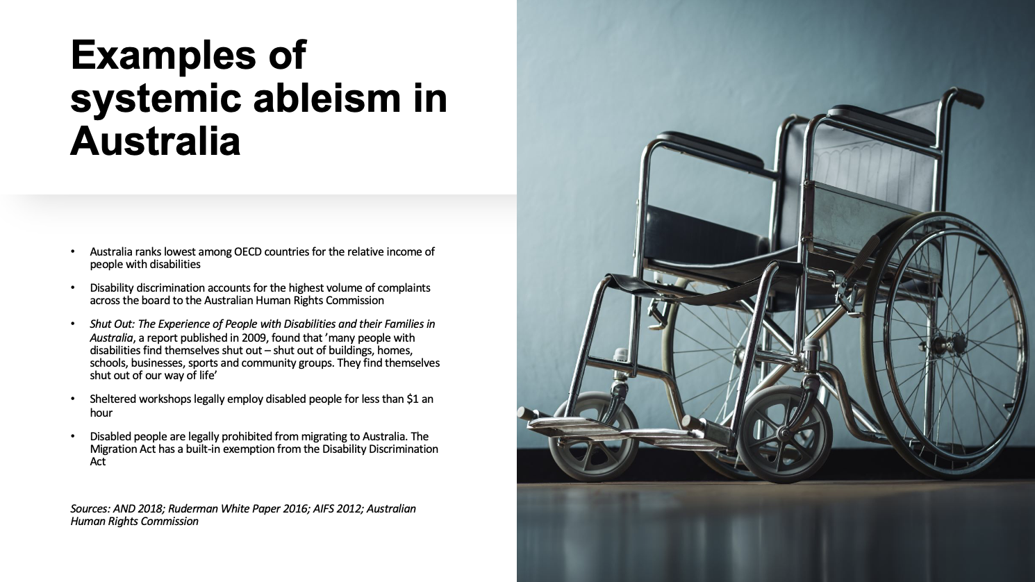

Slide 19
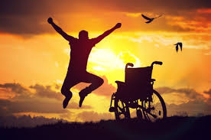
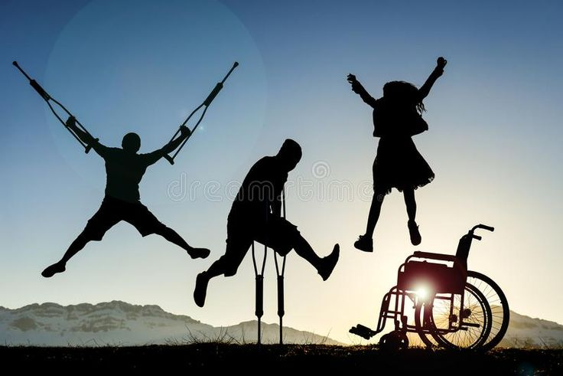
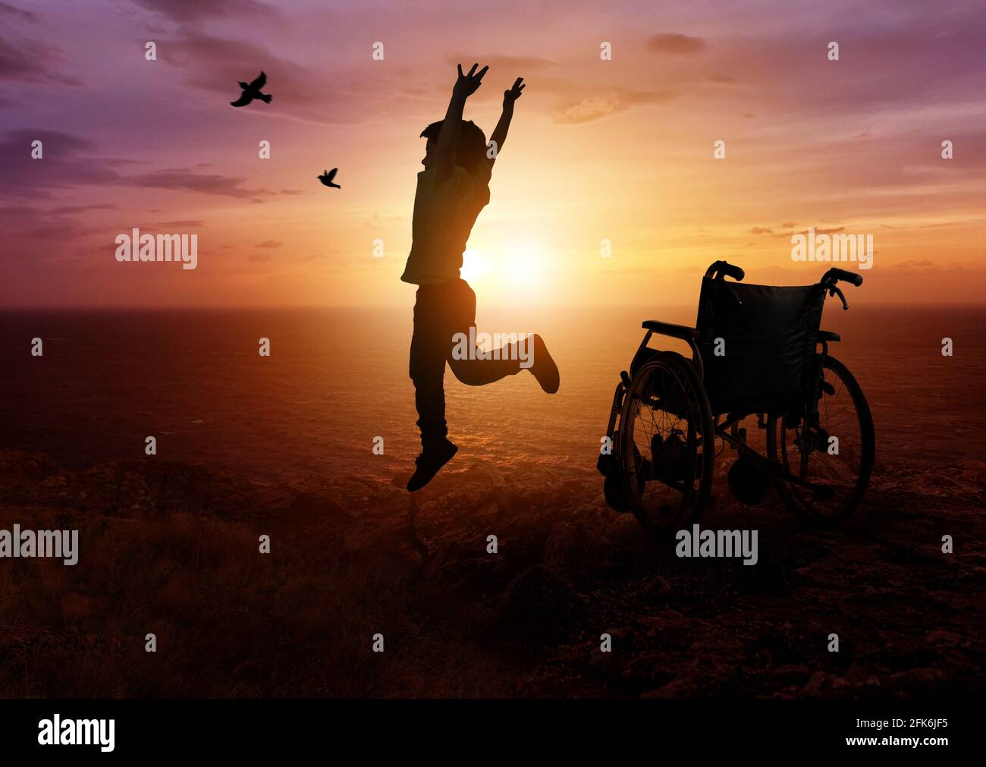
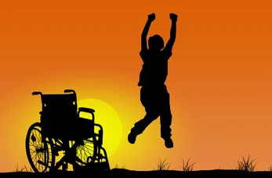
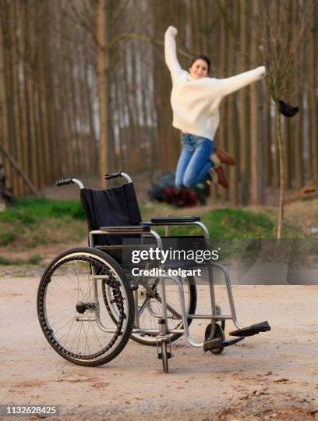
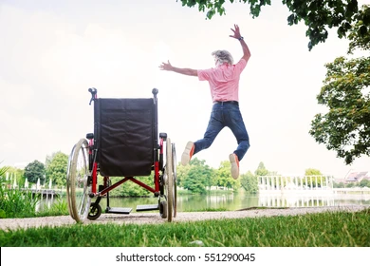
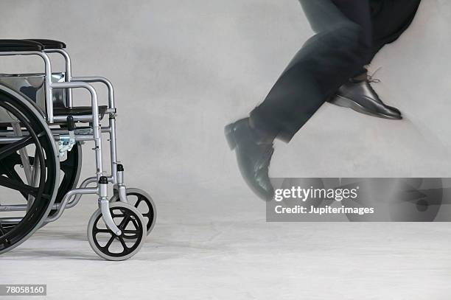

Slide 20
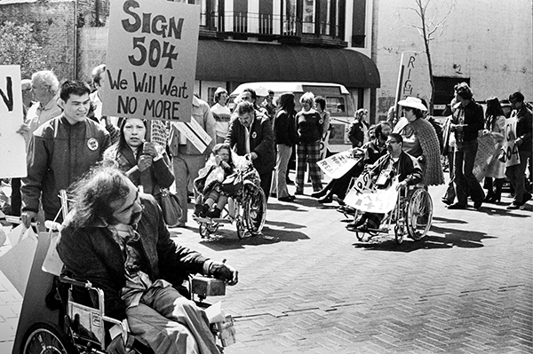
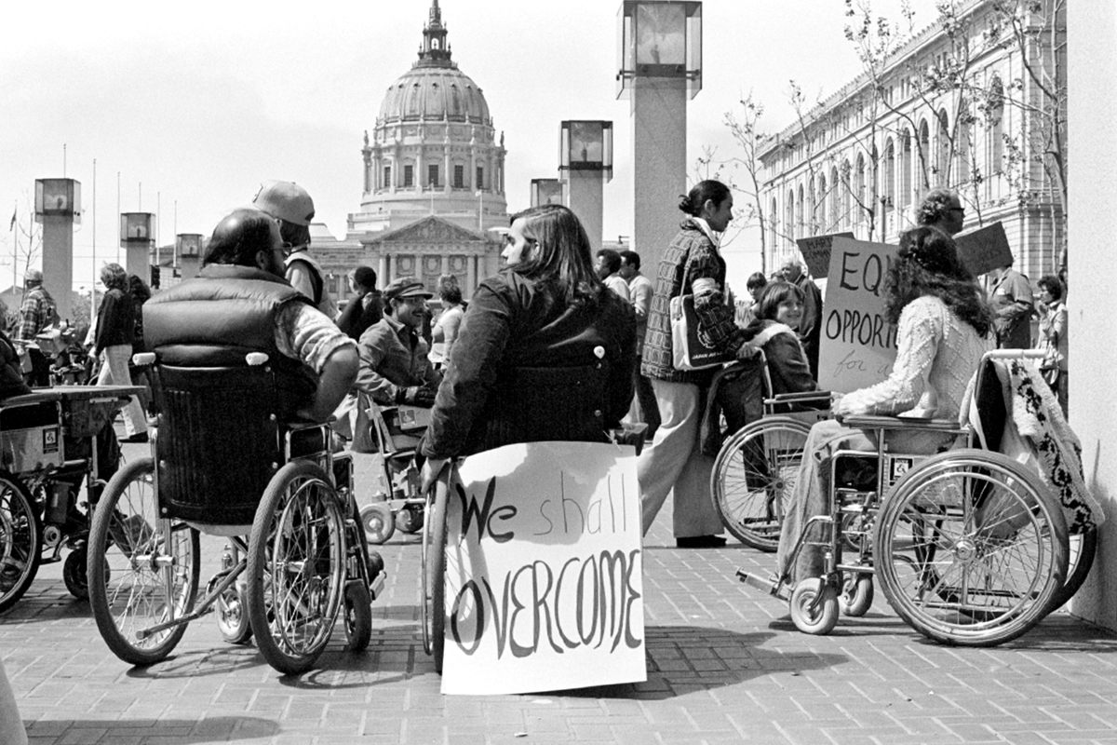
History of disability activism: the 504 sit-ins
In 1977, a group of disabled activists staged a sit-in to demand the passage of Section 504 of the Rehabilitation Act
The protest was successful and eventually led to the passage of the Americans with Disabilities Act, the first disability antidiscrimination law in the world (Australia passed the Disability Discrimination Act in 1992)
Only possible with community support from the Black Panthers, the Gay Mens' Butterfly Brigade, and trade unions (incl. the United Farm Workers and the International Association of Machinists)

Slide 21
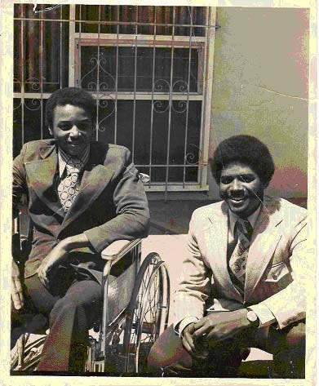
History of disability activism: the 504 sit-ins
“to my brothers and sisters that are Black and that are handicapped: Get out there, we need you. Come here, we need you. Wherever you are, we need you. Get out of your bed, get into your wheelchair. Get out of your crutches, get into your canes. If you can't walk, call somebody, talk to somebody over the telephone; if you can't talk, write; if you can’t write use sign language; use any method of communication that is all — all of it is open.
We need to do all we can.”
  – Dennis Billups (right), 1977, published in the Black Panther Party’s newsletter

Slide 22
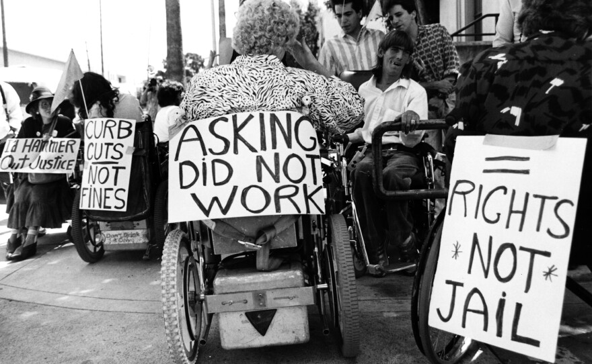
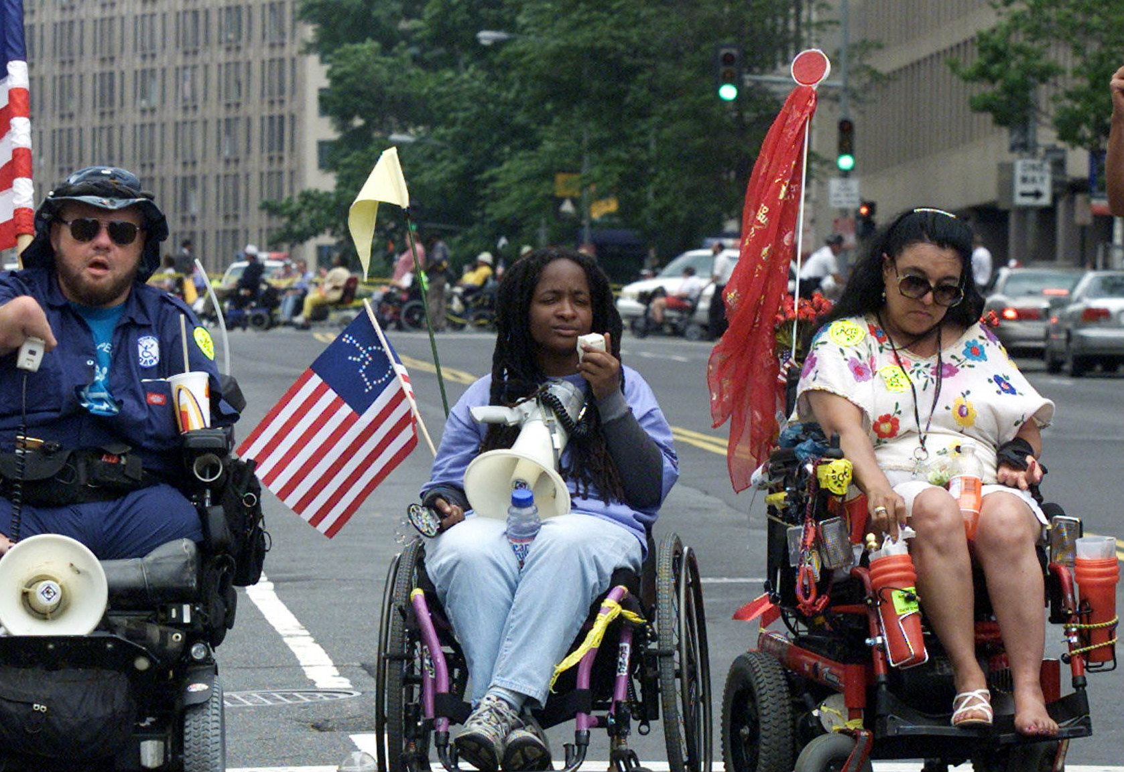
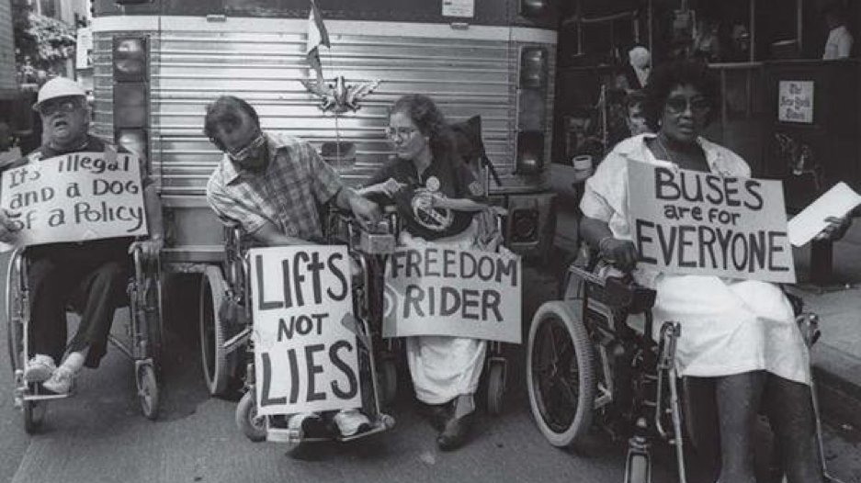
History of disability activism: ADAPT

Slide 23
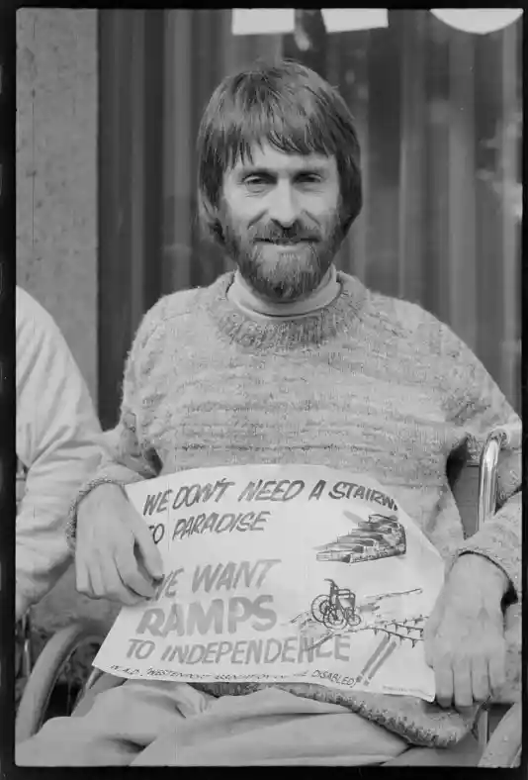
History of disability activism: protest actions in Australia
In the 1970s, a group of disabled people institutionalised in the ‘Home for Incurables’ in Ryde, Sydney, began a campaign to demand better care and support. Ultimately this led to devolution (de-institutionalisation)
In 1978, ten disabled activists from the Disabled People’s Action Forum blockaded a number of Melbourne buildings protesting inaccessibility
Also in 1978, a group of 100 disabled activists held a protest outside Canberra’s Parliament House condemning new legislation allowing over-taxation of government allowances. The law was rescinded
In 1979 Joan Hume and Genni Batterham organised a protest about the lack of wheelchair access at the opening of the Eastern Suburbs Railway

Slide 24
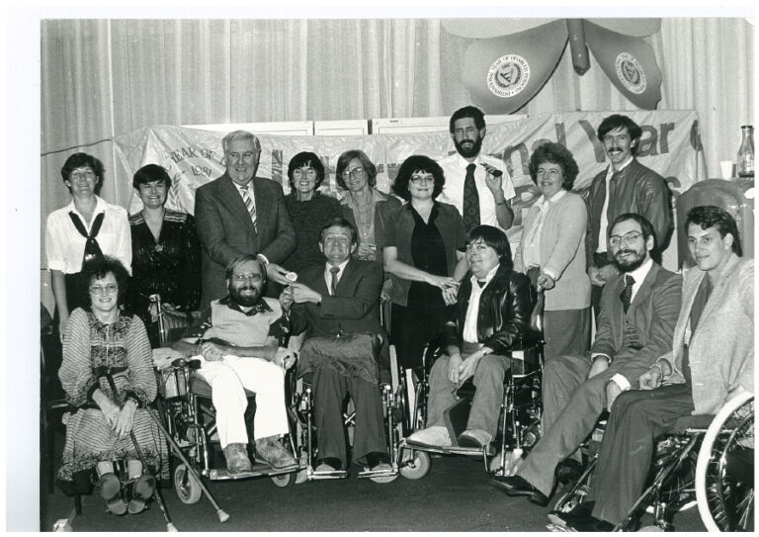
History of disability activism: Protest in Australia
In 1980, Ben Meads convened a meeting of the newly founded Union of Handicapped People (later changed to Handicapped Persons’ Alliance)
In 1981, the International Year of Disabled Persons, disabled activists (including Ben Meads, Joan Hume, Margaret Cooper, Geoff Bell, Jan Daisley, Wendy Potter, Graeme Innes, Robert Wood, Les Hume, Bronwyn Moye, John Moxon and others) founded the NSW branch of Disabled Peoples International
(later PWDA)
In 1983, Joan Hume, Lesley Hall, Jan Daisley and other members of Women with Disabilities Feminist Collective gathered to protest against the Miss Australia Quest, a charity event for the Spastic Centre (now Cerebral Palsy Association) where people with cerebral palsy were not allowed to attend

Slide 25
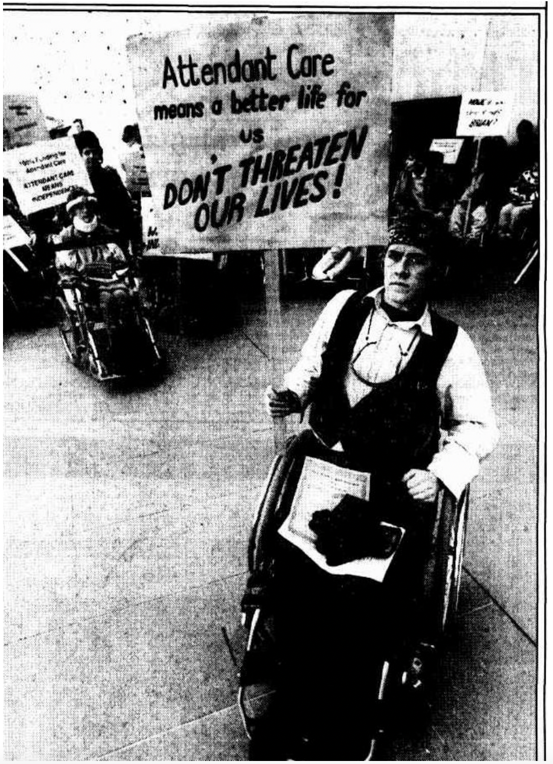
History of disability activism: Protest in Australia
In 1986, disabled activists including Rob Macnamara founded the Attendant Care Coalition (now Action for Community Living)
In the 1990s, disabled activists led by Bronwyn Moye blocked off Broadway in Sydney to protest public transport inaccessibility
In 1999, a group of disabled Aboriginal activists including Uncle Lester Bostock (Bundjalung) and Aunty Gayle (Leila) Rankine (Ngarrindjeri and Kaurna) gathered in Alice Springs, a watershed moment leading to the foundation of the Aboriginal Disability Network (later merged with First Peoples Disability Network)

Slide 26
Disability Rights vs Disability Justice
Focused on legislative reform, appeals to the state
Rights are applied and enforced by the legal system, governments, police and prisons
Seeks material structural changes (often on a short- term, single issue basis)
Focused on grassroots organising on a community level
Asks us to recognise that human rights frameworks are fallible – just because our rights are legislated doesn’t mean that they are upheld
Seeks long-term, lasting collective liberation

Slide 27
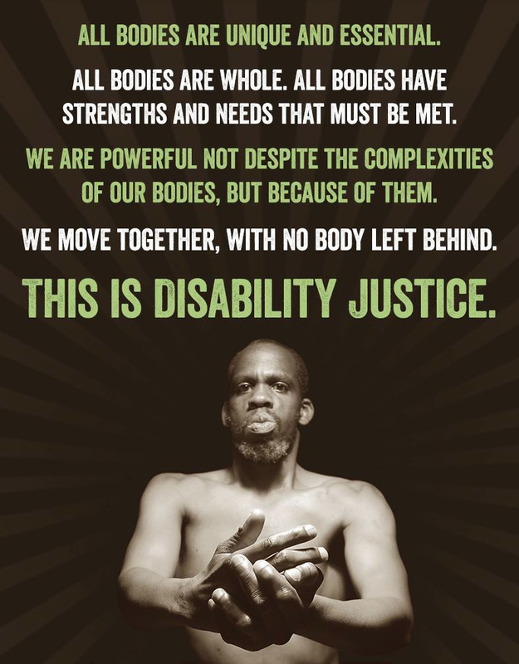
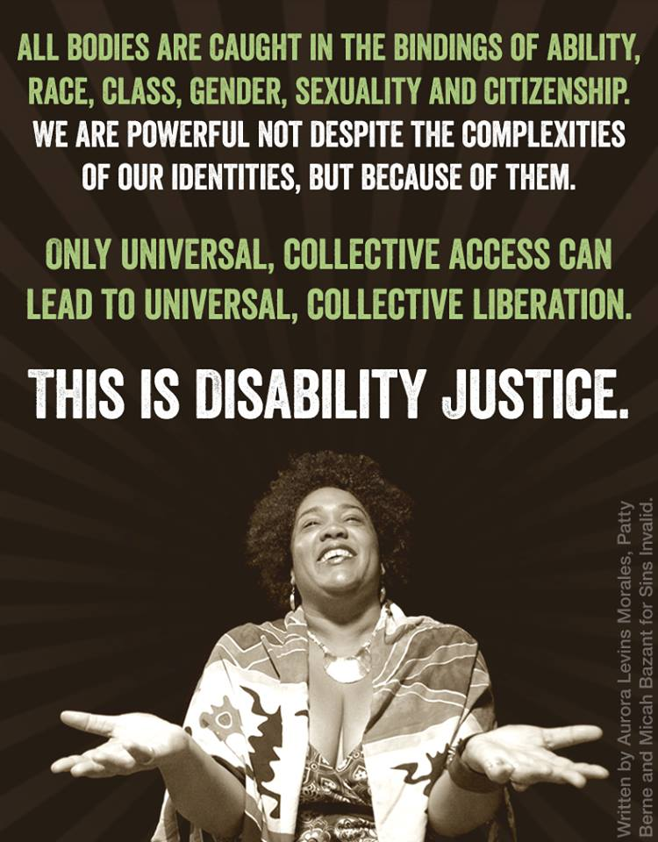

Slide 28
10 Principles of Disability Justice
Intersectionality
Leadership of those most impacted
Anti-capitalism
Cross-movement solidarity
Wholeness
Sustainability
Cross-disability solidarity
Interdependence
Collective access
Collective liberation
via Sins Invalid

Slide 29
Disability justice holds a vision born out of collective struggle, drawing upon legacies of cultural and spiritual resistance. Within a thousand underground paths we ignite small persistent fires of rebellion in everyday life. Disabled people of the global majority — Black and brown people — share common ground confronting and subverting colonial powers in our struggle for life and justice. There has always been resistance to all forms of oppression, as we know in our bones that there have also always been disabled people visioning a world where we flourish, a world that values and celebrates us in all our beauty.
Sins Invalid, Skin, Tooth and Bone: The Basis of Movement is Our People

Slide 30


Disability arts, advocacy, and community building
Roy de Maistre, Rhythmic composition in yellow green minor, 1919
Roland Wakelin, Syncromy in orange major 1919

Slide 31
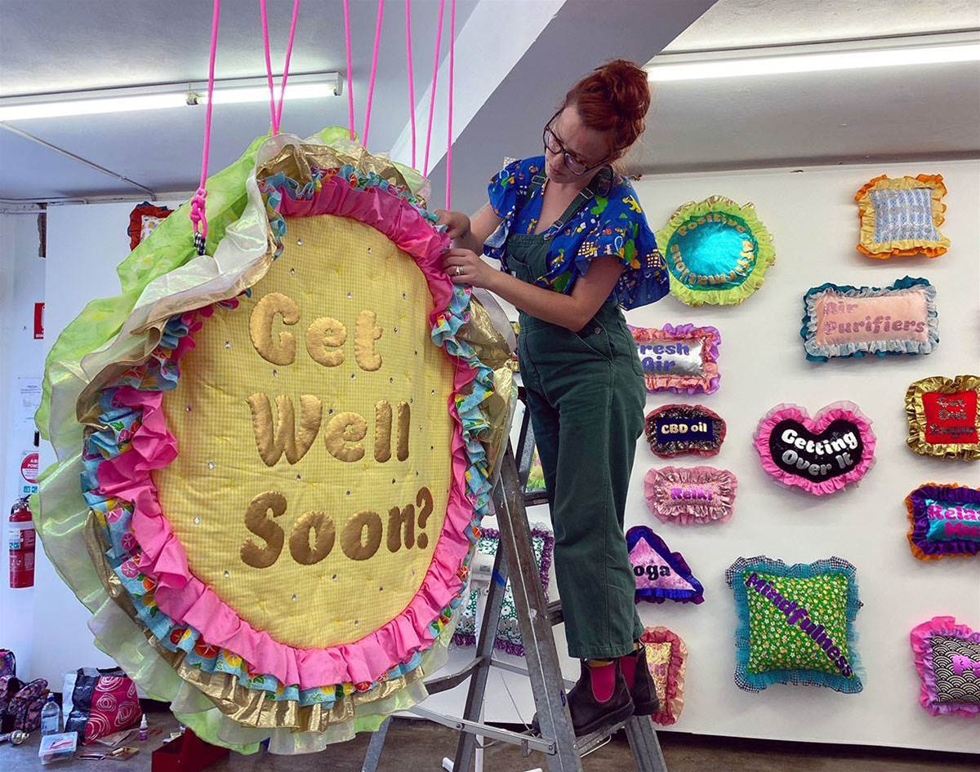
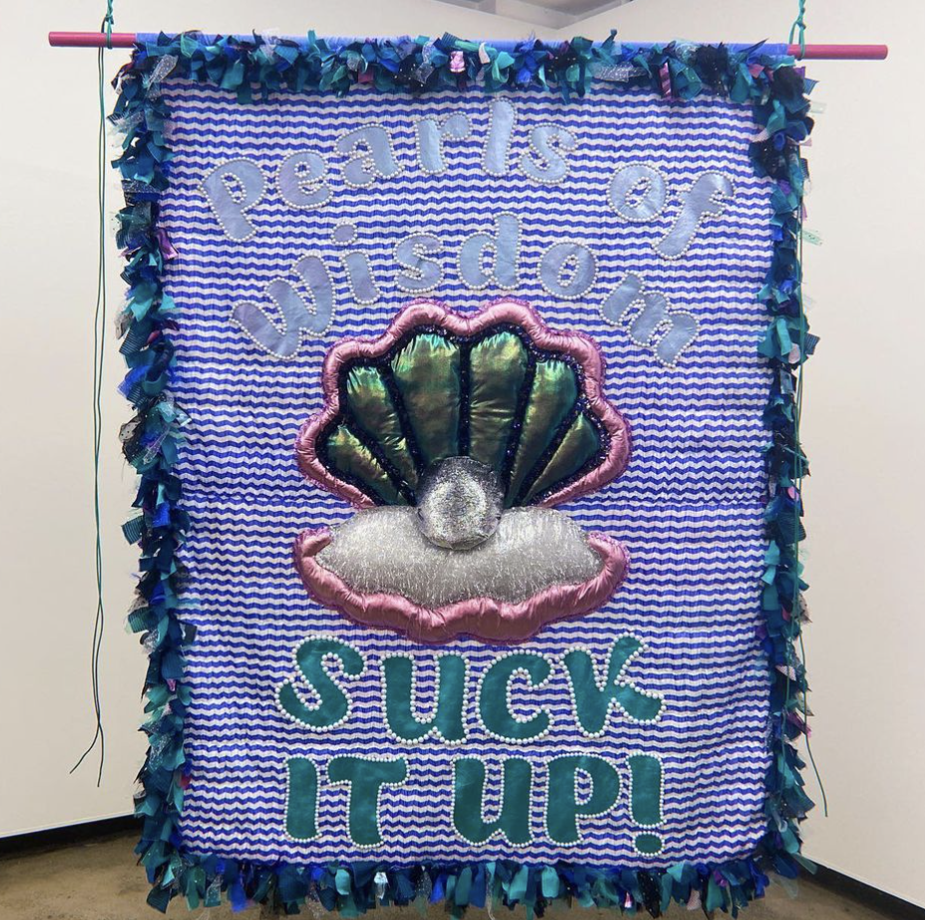
Disability arts, advocacy, and community building
Amy Claire Mills, Unsolicited Advice, 2021

Slide 32
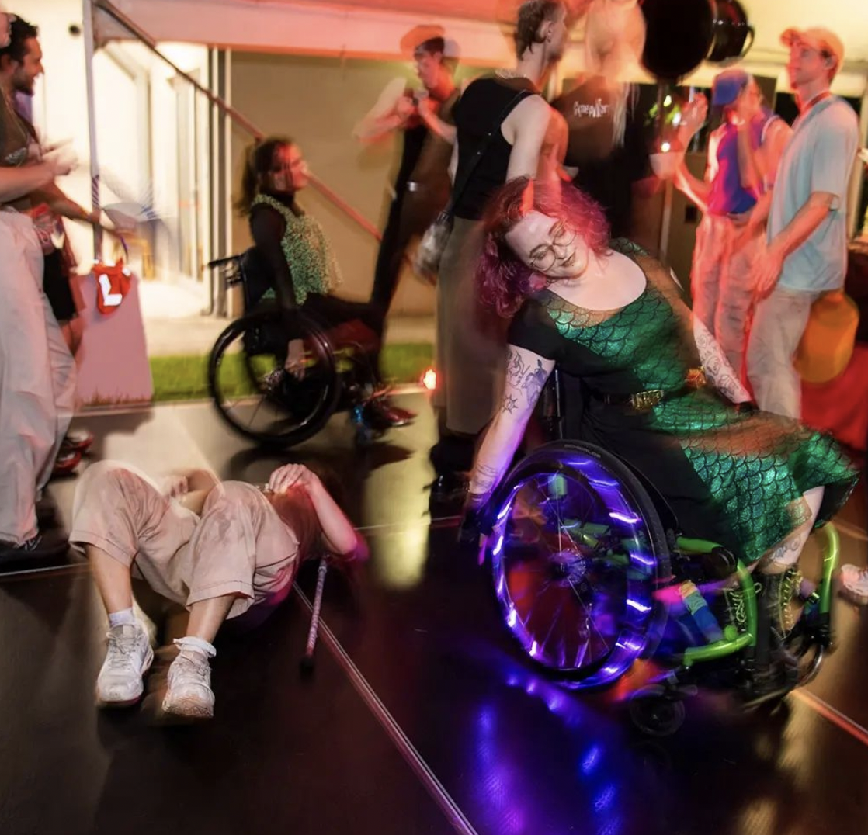
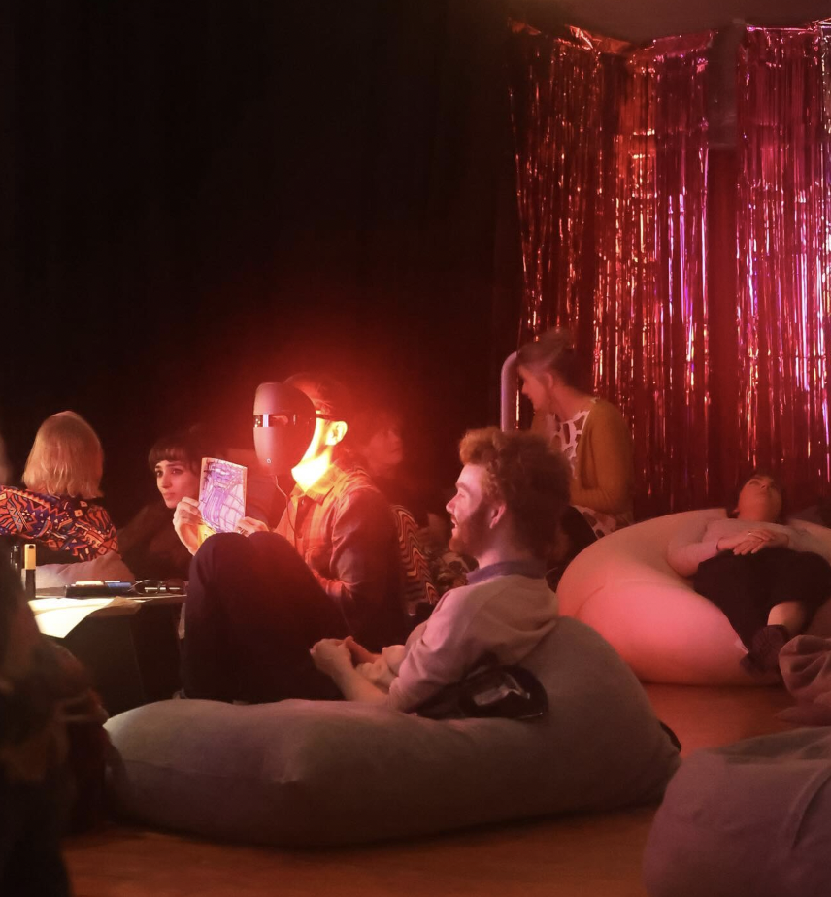
Disability arts, advocacy, and community building
Crip Rave Theory, organised by Riana Head-Toussaint

Slide 33
Types of activism
Action First
Prioritises information security and anonymous action
Good for single actions, short-term goals
Predetermined and usually strict roles
Potential capacity for ‘riskier’/more high-impact actions
Team First
Prioritises relationship building and pre-existing social groups
Good for longer term planning and movement building
Flexible/multiple roles and more informal communication
Creating affinity groups or blocs that build internal trust and capacity for sustainable organising
– via the Whistleblowers, Activists and Communities Alliance

Slide 34
Types of actions
Marches and rallies
Demonstrations
Speaking events, conferences
Sit-ins, die-ins
Walkouts (of work, school)
Strikes, pickets
Vigils, memorials
Civil disobedience
Lawsuits
Boycotts, divestment, sanctions
Mutual aid
Letter writing, calls, petitions
Protest art, music, poetry
Social media, culture jamming
Online campaigns
Electoral organising
Hacktivism
Community building

Slide 35
What can you do?
Learn from those who came before us
Get in where you fit in
Look for spaces that already exist, and build up
Use your existing skills and upskill where necessary
Challenge your assumptions about what is possible! We can build a better world together

Slide 36
Ask yourself:
What resources are needed? Who will supply them?
What skills do I bring to the table? What skills are missing from the group as a collective?
Am I politically aligned with these people? Do we agree on methods of political change?
If we don’t agree, can we still work together?
Is the direct action or collective organizing strategy being discussed something I feel secure in being involved in?
– via the Whistleblowers, Activists and Communities Alliance

Slide 37
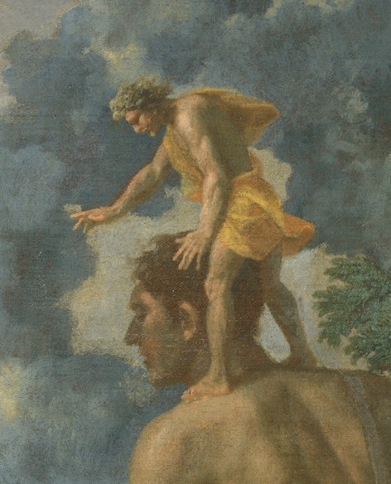
Standing on the shoulders of giants
Cedalion standing on the shoulders of Orion; detail from Blind Orion Searching for the Rising Sun by Nicolas Poussin, 1658, Metropolitan Museum of Art

Slide 38
Where can you connect?
JOIN YOUR UNION!!!
Get involved in local grassroots community groups, eg the Disability Justice Network, Sydney Queer and Disabled community group (SQuaD), Pride in Protest, Food Not Bombs, Australian Palestine Advocacy Network
Get involved in the disability advocacy sector, eg People With Disabilities Australia, First Peoples Disability Network, Women With Disabilities Australia, National Ethnic Disability Alliance, Disability Advocacy Network Australia, Children and Young People with Disability Australia, AIDS Council Of NSW (ACON), the Council for Intellectual Disability, Intellectual Disability Rights Service, Physical Disability Council NSW, Deaf Australia, Autistic Self Advocacy Network
Get involved with factional political groups (eg Solidarity, the Australian Communist Party, the Communist Party of Australia, Socialist Alliance, the Greens)
If relevant, join student disability collectives
Get involved in disabled art, literary, radio/podcast and performance projects, eg Sunder literary journal, Bramble literary journal, Crip Rave Theory, Arts Access Australia, Riverside Theatre’s Beyond the Square, No Strings Attached, Back to Back Theatre, Rollercoaster Theatre, Milk Crate Theatre, The Boldness/3cr Radio, Chronically Chilled podcast, Only Human, Raising Our Voices, Airwaves Access Radio
Find a couple of mates and occupy a building; block off a street; arrange a banner drop from a high place like a tall building or bridge over a highway; set fire to something (FOR LEGAL REASONS THIS IS A JOKE. ALWAYS CONSULT LEGAL ADVICE & EXPERIENCED ACTIVISTS BEFORE ATTEMPTING CIVIL DISOBEDIENCE)

Slide 39
Resources (activism and movement building)
Sins Invalid, Skin, Tooth and Bone: The Basis of Movement is Our People https://www.sinsinvalid.org/news-1/2020/6/16/what-is-disability-justice
Crowdsourced Lessons from the Disability Justice Movement https://commonslibrary.org/disability-justice-links/
The ADAPT activist handbook https://adapt.org/the-adapt-activist-handbook/
Leah Lakshmi Piepzna-Samarasinha, Care Work: Dreaming Disability Justice https://brownstargirl.org/care-work-dreaming-disability-justice/
Resistance and Hope: Essays by Disabled People. https://disabilityvisibilityproject.com/resist/
Disability Visibility: First-Person Stories from the Twenty-First Century. https://disabilityvisibilityproject.com/book/dv/
Common Conversations: Insights into activism https://commonslibrary.org/commons-conversations-podcast/

Slide 40
Resources (history of disability activism)
Defiant Lives (2017) https://defiantlives.com/
Crip Camp: A Disability Revolution https://www.netflix.com/au/title/81001496
Agents of our own destiny: activism and the road to the disability. 2021. https://apo.org.au/node/314895
https://www.aph.gov.au/Parliamentary_Business/Hansard/Hansard_Display?bid=committees/commsen/03d1782b-2e17-4eb7-8221-2012f46788e3/&sid=0001
Joan Hume’s PWDA 30th anniversary speech, 2011. https://pwd.org.au/about-us/our-history/joan-hume/
Telling it Like it Is: Inquiry into Aboriginal Disadvantage, 2007. https://fpdn.org.au/wp-content/uploads/2016/04/tellingitlikeitis.pdf
Yarning Disability, 2023 https://commonslibrary.org/the-first-peoples-disability-network-yarning-disability-podcast/
The Geoff Bell Archive https://digitised-collections.unimelb.edu.au/items/df02cb22-86ed-552a-b284-3914449dc739
Deinstitutionalisation and housing futures, https://www.ahuri.edu.au/sites/default/files/migration/documents/AHURI_Positioning_Paper_No1_Deinstitutionalisation_and_housing_futures.pdf
Anita Cameron on ADAPT https://19thnews.org/2023/05/anita-cameron-disability-rights-activist-retiring-protests/
Margaret Cooper, ‘The Australian Disability Rights Movement Lives’ https://www.researchgate.net/publication/248912538_The_Australian_Disability_Rights_Movement_Lives
Disability Justice Network of Australia: Palestine Solidarity Statement https://overland.org.au/2021/06/disability-justice-network-of-australia-palestine-solidarity-statement/

Slide 41
Any questions?

