Slide 1
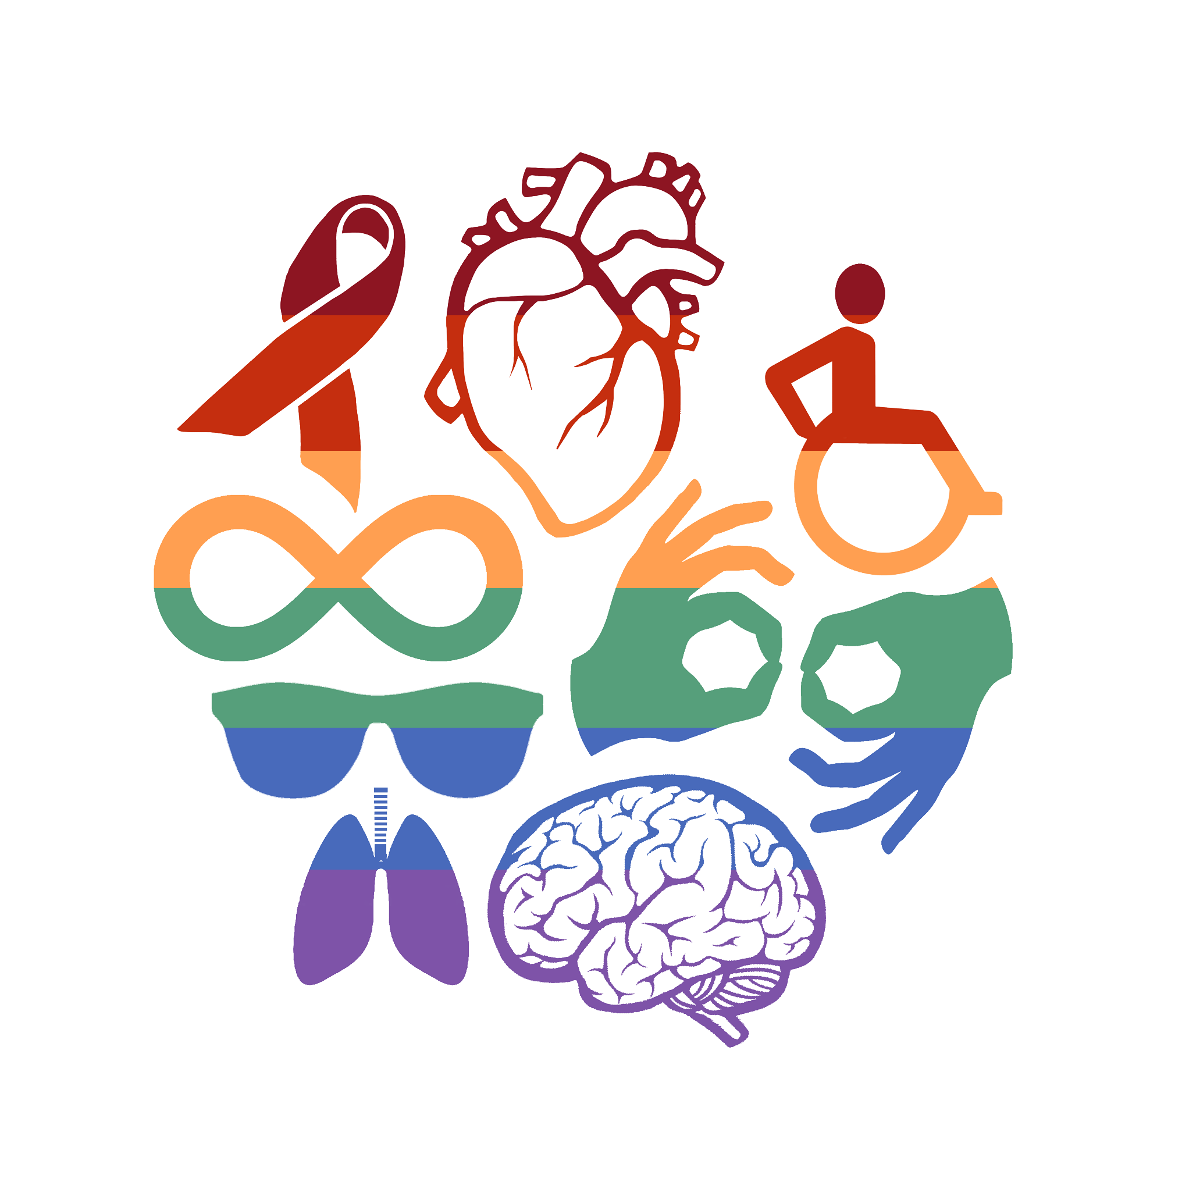

QUEERING CRIP, CRIPPING QUEER
Workshop facilitated by Robin Eames

Slide 2
This workshop is being held on the occupied lands of the Turrbal and Yugara peoples.
Sovereignty was never ceded.
This land always was and always will be Aboriginal land.
YOU ARE ON ABORIGINAL LAND

Slide 3
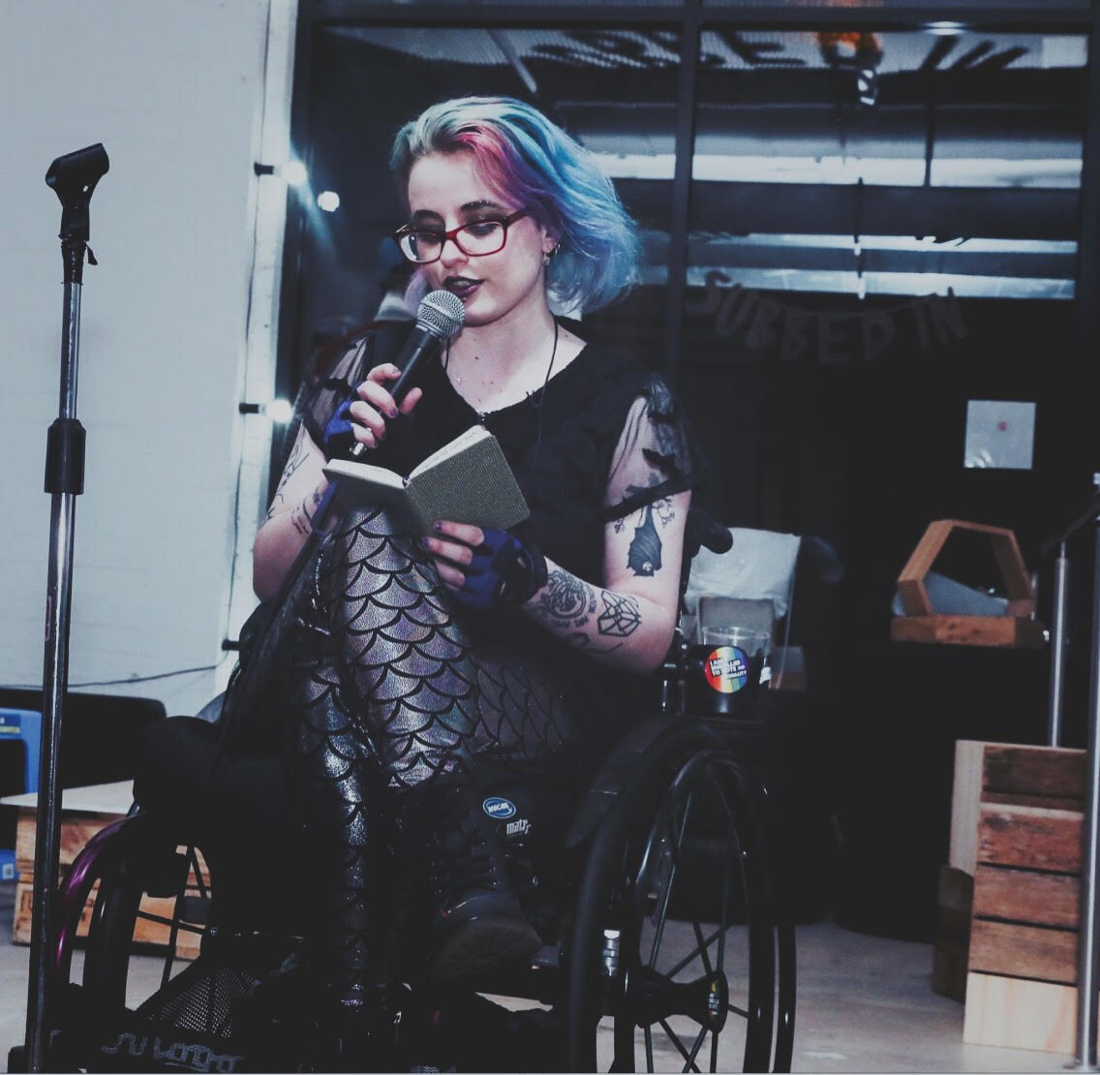
who’s this
nerd???

Slide 4
CRIP ETYMOLOGY
CRIP: reclaimed term deriving from CRIPPLE
CRIPPING is used in much the same way as QUEERING, i.e. subverting something (a text, a space, or an idea) in a disability-positive way.
As with any reclaimed slur, you should be careful with your use of the words CRIP and CRIPPING, especially if they’re not terms that you identify with personally.
  Good: “Robin is a queercrip poet”, “Robin identifies as part of the crip community”, “Robin studies radical crip theory”
  Not so good: “This is Robin my cripple friend”, “There was a crip on my bus today”, “why are crips so bitter about inaccessibility all the time?”

Slide 5
CRIP ETYMOLOGY
CRIPPLE has been used since the 12th century to refer to people with physical/mobility impairments, especially those affecting one or both legs. CRIP is broader but still in many ways located in physical/mobility disability. This can make its invocation as an inclusive community term a bit complicated.
CRIP overlaps and intersects with other disability identities. Someone might identify as part of the crip community without identifying personally as a crip.
When we talk about cripping texts, spaces, and ideas, it’s important not to obscure the experiences of D/deaf, disabled, and/or neurodivergent people who don’t identify as crips.

Slide 6
—CAITLIN WOOD, disability activist and editor of CRIPTIQUES
“Crip is my favorite four-letter word. Succinct and blunt, profane to some, crip packs a punch. Crip is unapologetic. Audacious. Noncompliant. Crip takes pleasure in its boldness and utter disinterest in appearing “respectable” to the status quo. It’s a powerful self-descriptor, a cultural signifier, and a challenge to anyone attempting to conceal disability off in the shadows. Crip is anti-assimilationist and proud of it. Crip is outspoken with no patience for nonsense. Crip is my culture and it’s where I want to be.”

Slide 7
DISABILITY AS IDENTITY
The way disability is framed is usually in terms of individual hardship or misfortune, rather than as a facet of identity or culture/community
Disability is thought of as something that happens to you (or your parents!) rather than part of who you are. It’s taken as a given that disability is inherently bad and to be avoided, and that it is better to be abled and neurotypical rather than disabled or neurodivergent.
BUT many disabled people do not feel this way at all! Lots of us feel great love and pride in disabled identity & community

Slide 8
THE SOCIAL MODEL OF DISABILITY
aka
IN CAPITALIST AUSTRALIA,
SOCIETY DISABLES YOU

Slide 9
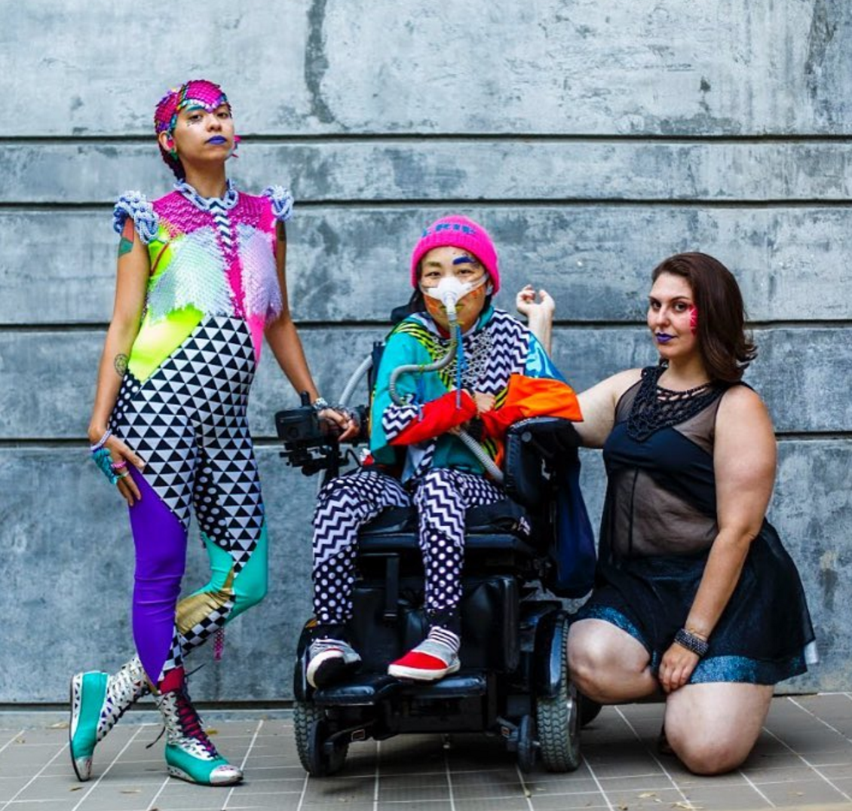
Sky Cubacub, Radical Visibility Manifesto
“This movement celebrates the contradiction. We, as QueerCrips, are living contradictions in a society that wants us dead.”

Slide 10
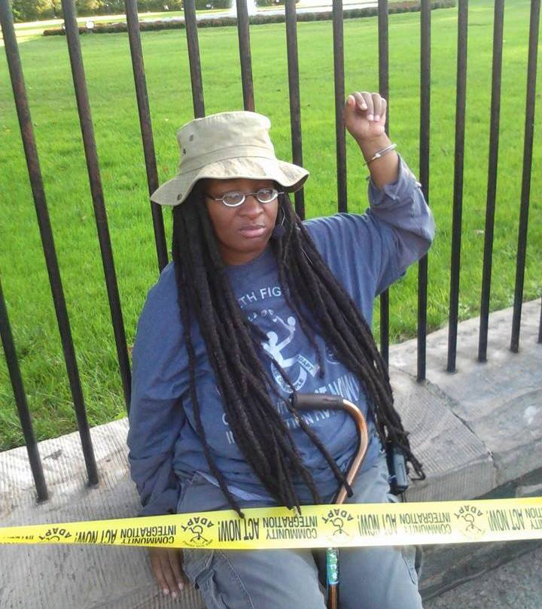
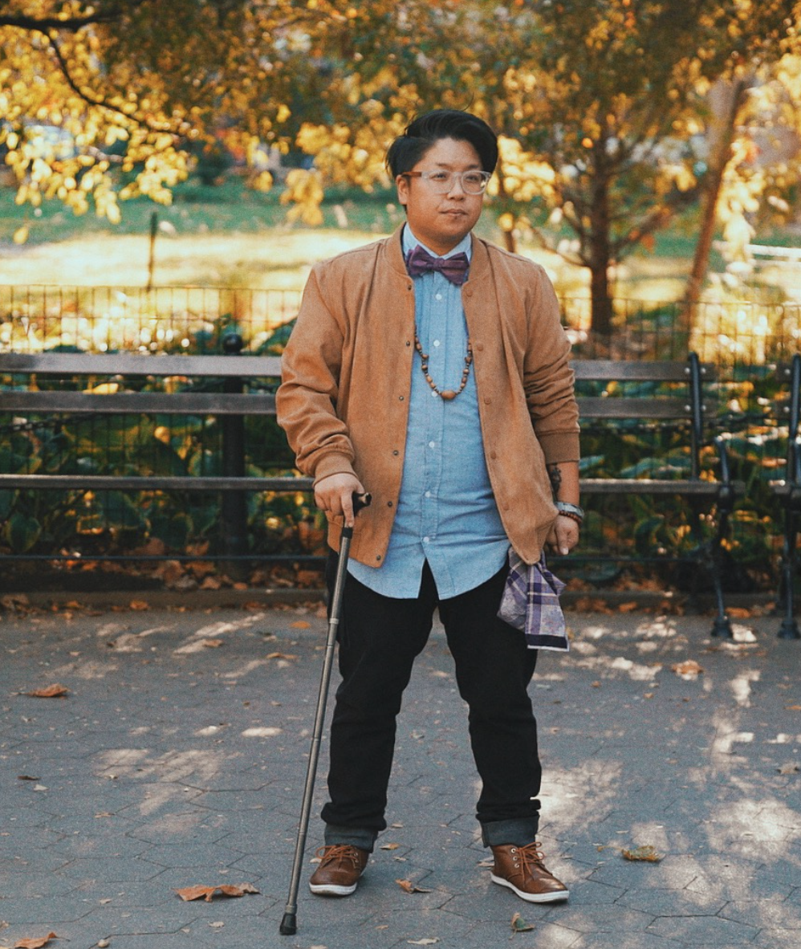
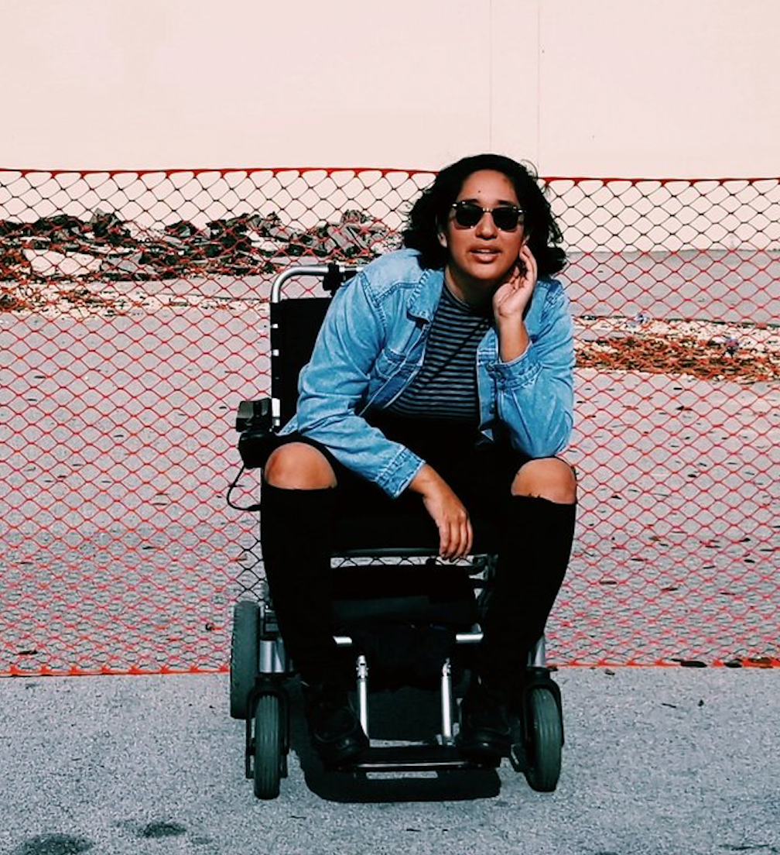
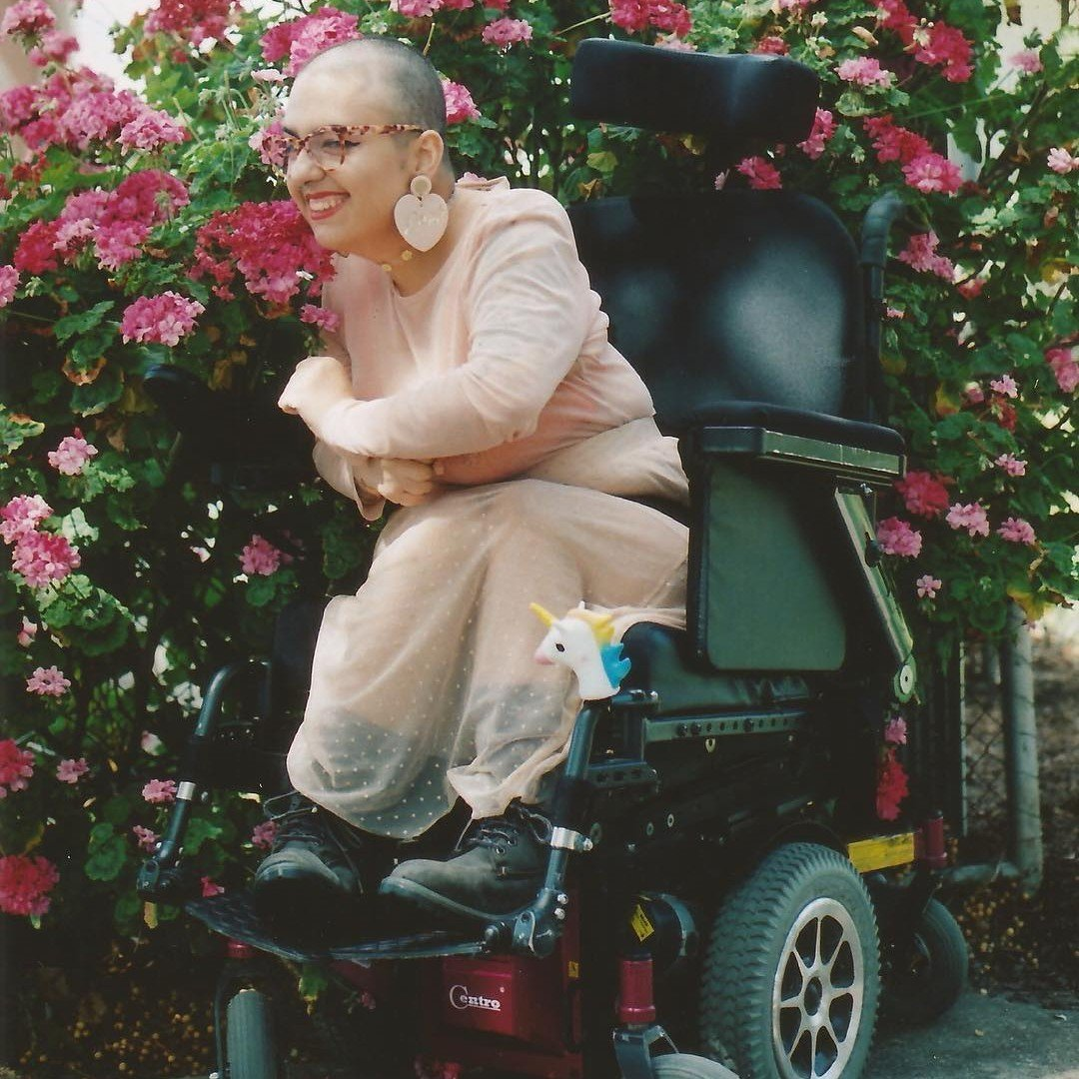
some rad queercrip activists!
Anita Cameron, Kay Ulandlay Bennett, Annie Segarra, Ruby Allegra
See also: Dominick Evans, Corbette O’Toole, Lydia X. Z. Brown, Eli Clare, Mia Mingus, Cal Montgomery, DJ Kuttin Kandi, Victoria Rodríguez-Roldán, Quin Eli, Jax Jacki Brown, Daniel Monks, Georgia Rose Cranko,
& many many more

Slide 11
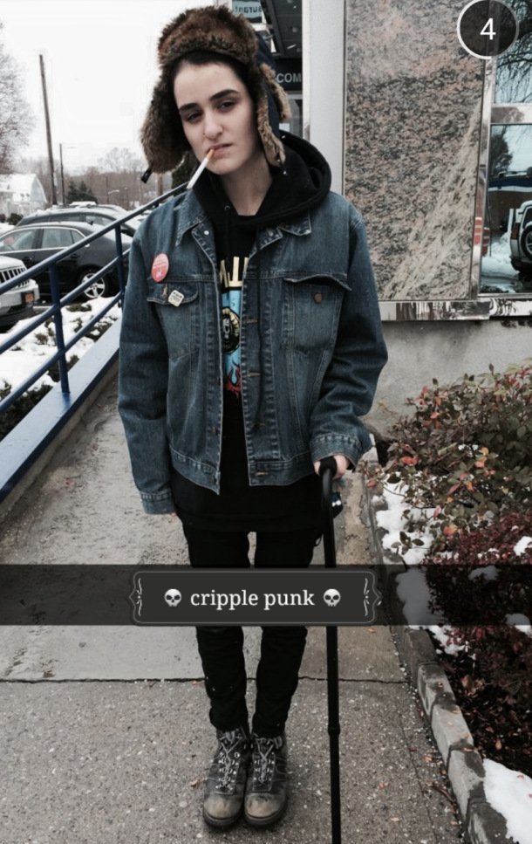
#cripplepunk
A movement founded by Tyler Trewhella (Tai)
1996-2017
“To be disabled and not hate yourself for it is a profound act of resistance.”

Slide 12
SHARED HISTORIES
Queer and crip identities have historically been (and continue to be!) pathologised and criminalised
Homosexuality was listed as a mental disorder in the DSM until 1987
“Gender identity disorder” was listed in the DSM as a mental disorder until 2012, when it was replaced with “gender dysphoria”
“Transsexualism” was listed in the ICD-10 as a mental disorder until this year. The new edition, the ICD-11, lists “gender incongruence” as a sexual health condition
Asexuality is still listed as a mental disorder in both the DSM-5 and ICD-11
Intersex variations are still listed as “disorders of sex development” in the ICD-11, contributing to the dangerous rhetoric justifying unnecessary and traumatic “normalizing” surgeries on infants

Slide 13
SHARED HISTORIES
We also have a shared history (and present) of criminalisation and institutionalisation
Because queer identities were pathologised as mental or sexual disorders, queer people also experienced forced institutionalisation in mental or “benevolent” asylums
Sodomy was only wholly decriminalised on a federal level in Australia in 1997. There are many areas in the world where it is still illegal to be queer or trans
“Ugly laws” made it illegal to be visibly disabled (“diseased, maimed, mutilated or deformed”) in public from the 1700s to 1970s
Australia is only gradually de-institutionalising disabled people; there are still a huge number of young disabled people in aged care homes due to lack of adequate social supports
People with psychiatric and cognitive disabilities are overrepresented in incarcerated populations even though we are no more likely to commit crimes than anyone else

Slide 14
SHARED HISTORIES
Queer, trans, and intersex people are disproportionately likely to experience disability, often because of trauma and marginalisation
Many historical queer heroes were disabled! For example:
  Marsha P. Johnson
  Stormé DeLarverie
  Frida Kahlo
  Oscar Wilde
  Freddie Mercury
  Michelangelo
  Leonardo da Vinci

Slide 15
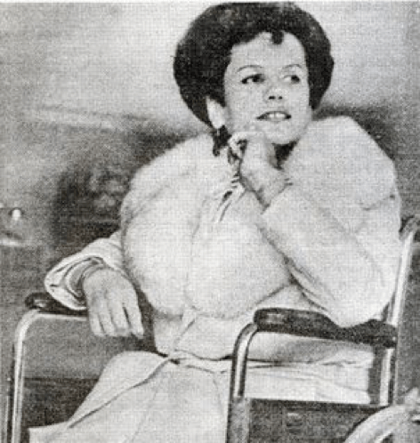
BOBBIE LEA BENNETT
Transgender woman and wheelchair user
Hugely important radical activist who mobilised her community to fight for gender affirmation surgeries to be covered under Medicare in the US in the 1970s, based on her knowledge of disability social security

Slide 16
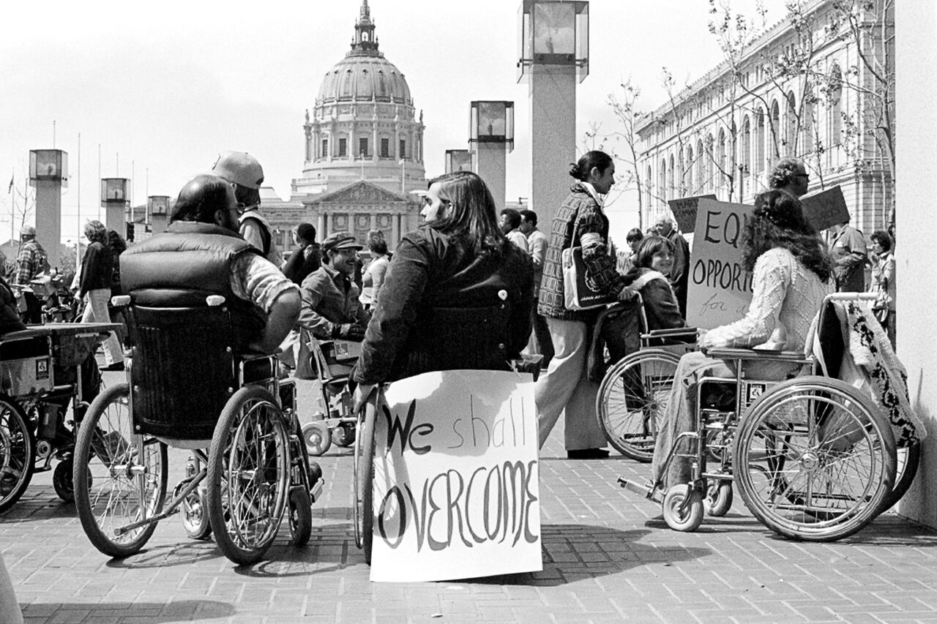
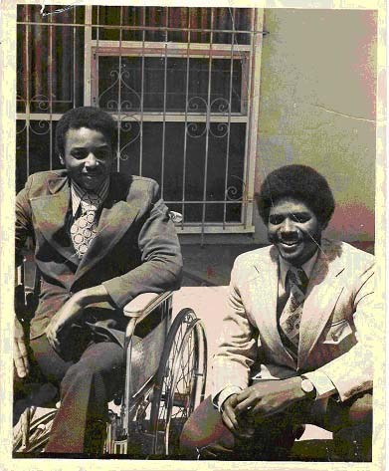
504 SIT-INS 1977

Slide 17
—CAL MONTGOMERY, disability activist
“Pride is celebrated by openly admiring the style with which your friends get arrested and are led with quiet dignity to accept their tickets. Or the courage they show in the sweaty half-second before the takedown. Or the shuddering bravado as they are released into the unit from days of seclusion, pretending they are fine. Pride is celebrated in gallows humor and in silent witness as friends thread their lives unevenly through the treacheries of the world…
Together. Pride is an understanding that we are in this together. It is solidarity with other people who share your experience of a society which regards you, and demands that you regard yourselves, as valueless.”

Slide 18
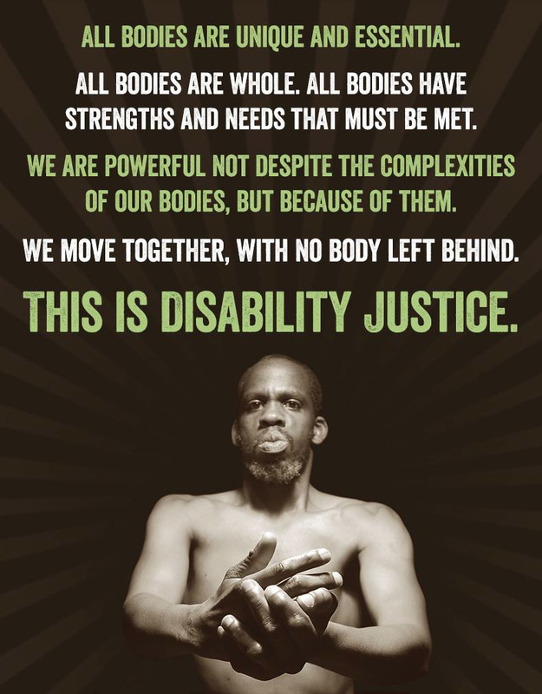
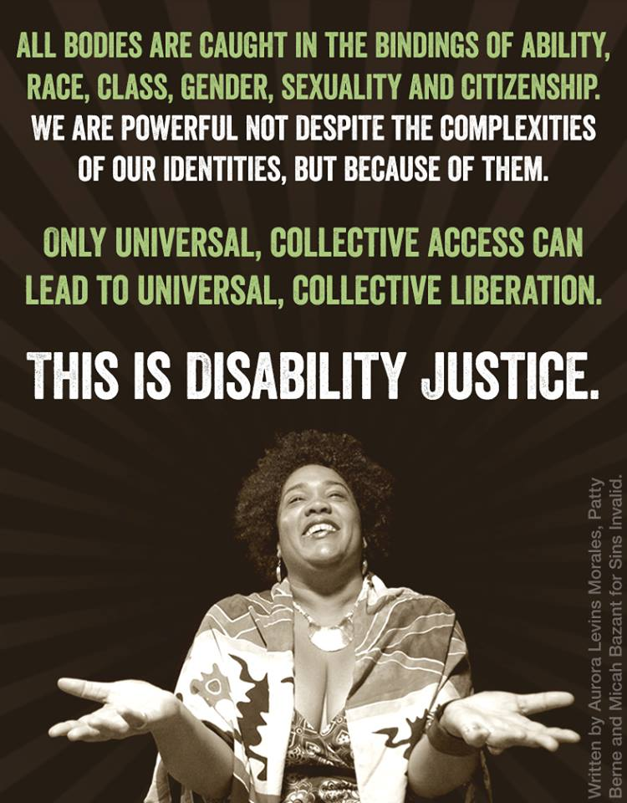
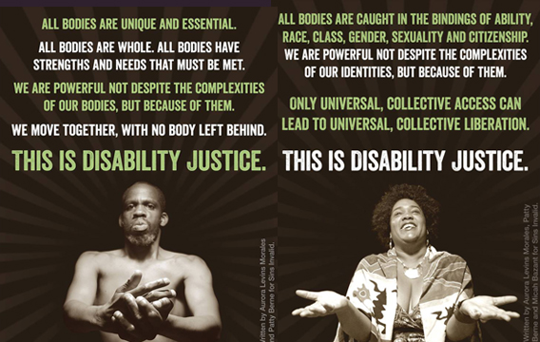
DISABILITY JUSTICE & SOLIDARITY
Aurora Levine Morales, Patty Berne, Micah Bazant, & Leroy Moore for SINS INVALID

Slide 19
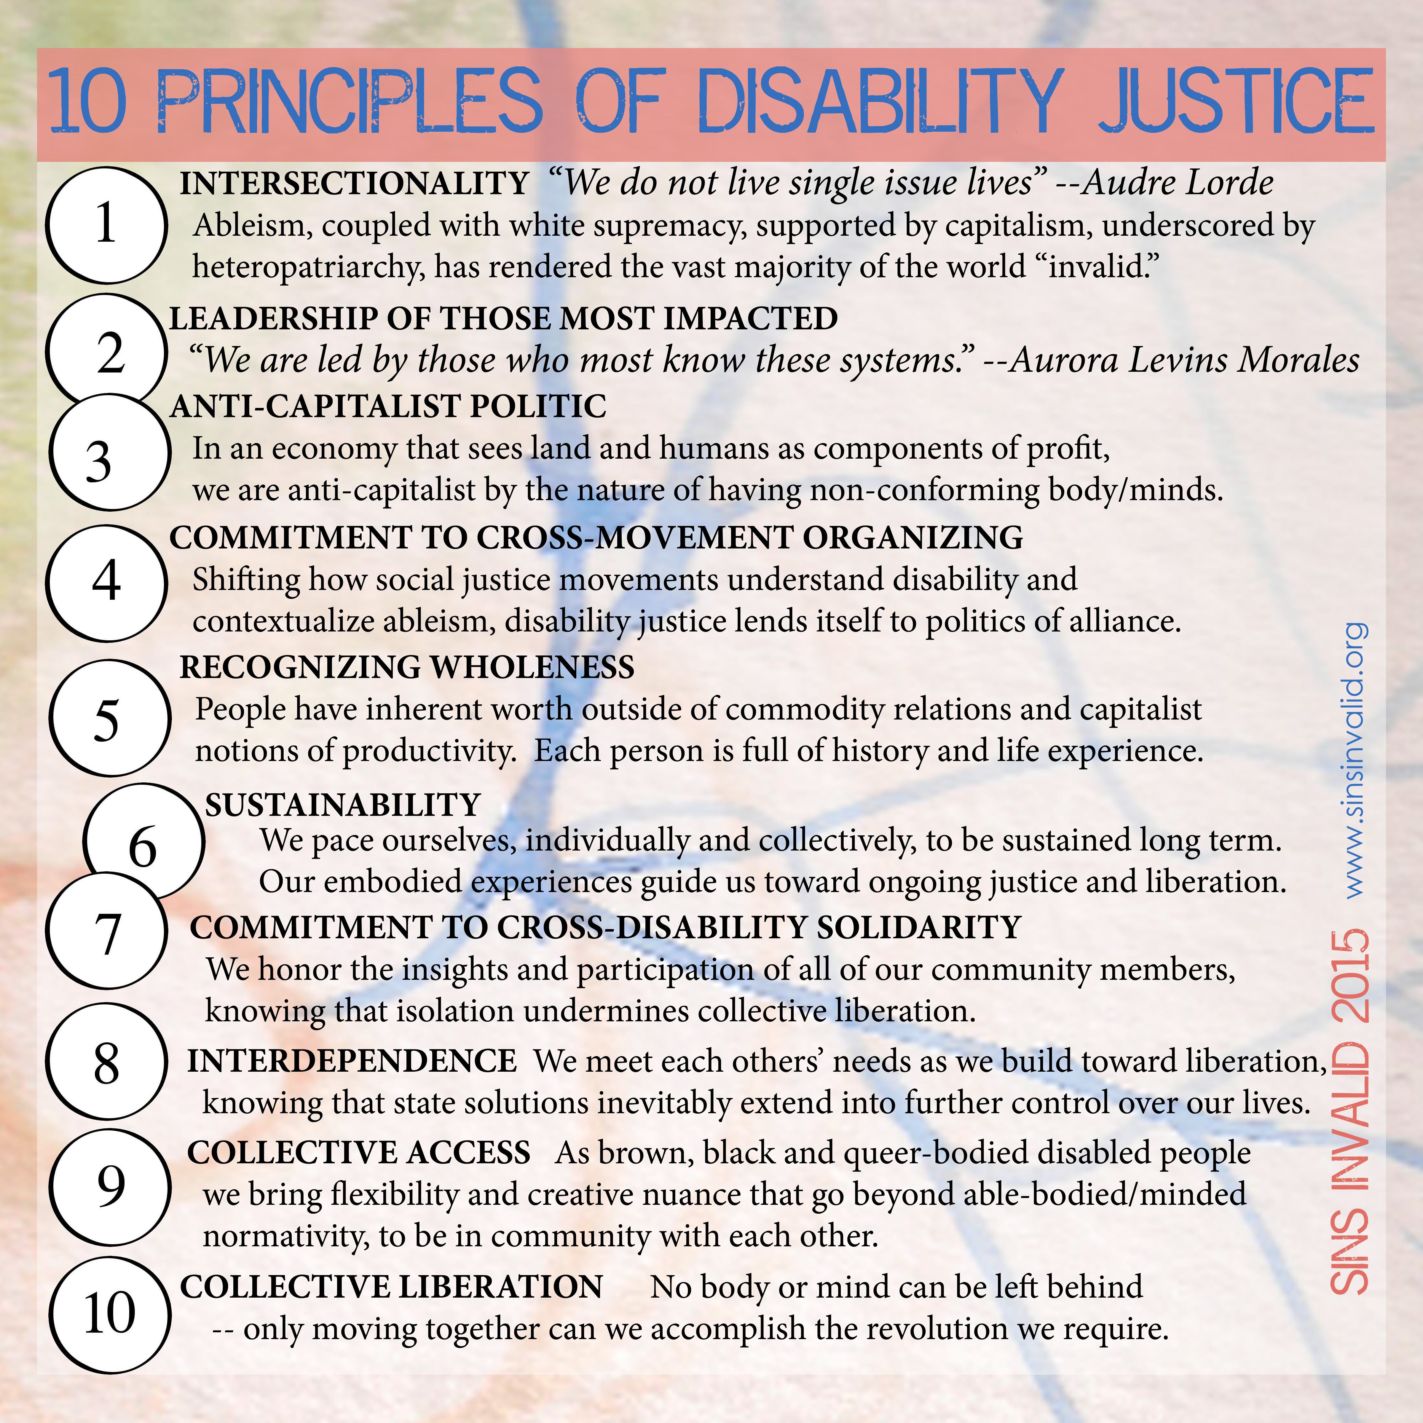

Slide 20
Audre Lorde
“There is no such thing as a single issue struggle because we do not lead single issue lives.”

